Slide 1
Social Network Analysis in R

Slide 2
Social Network Analysis (SNA) is the process of exploring the social structure by using graph theory.
It is mainly used for measuring and analyzing the structural properties of the network.
It helps to measure social network relationships (Facebook, Twitter likes comments following etc..), Email connectivity, flows between groups, organizations, and other connected entities.
A network is represented as a graph, which shows links (if any) between each vertex (or node) and its neighbors.
Edge: — A-line indicating a link between vertices.
Component: — A group of vertices that are mutually reachable by following edges on the graph.
Path: -The edges followed from one vertex to another are called a path.

Slide 3
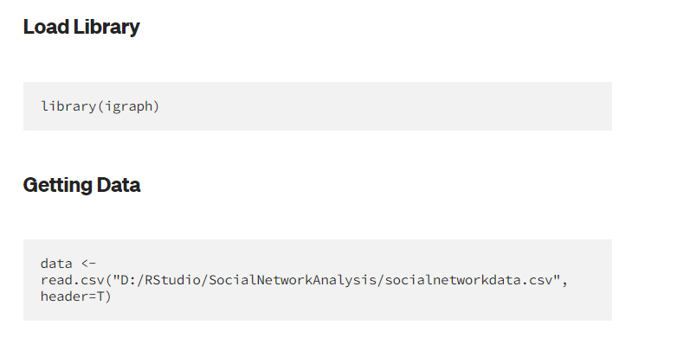

Slide 4
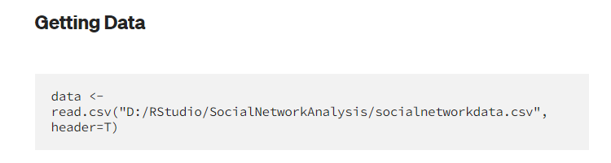
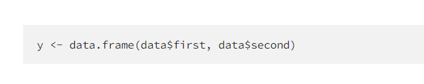

Slide 5
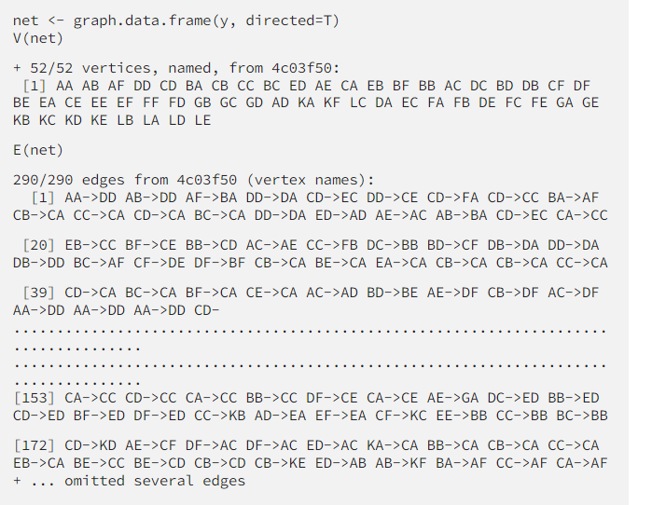

Slide 6
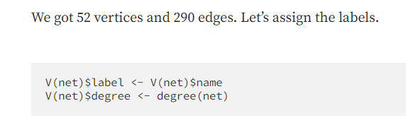

Slide 7
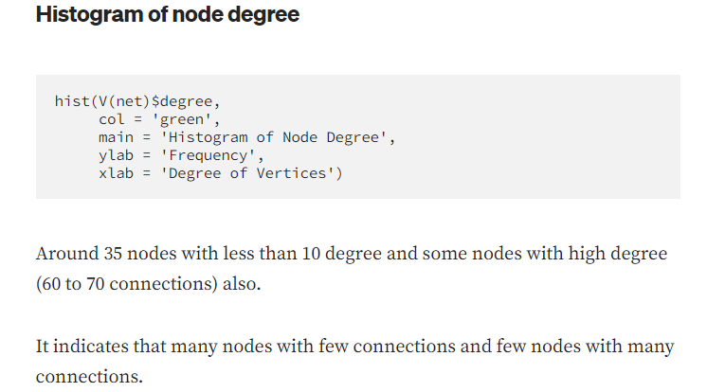

Slide 8
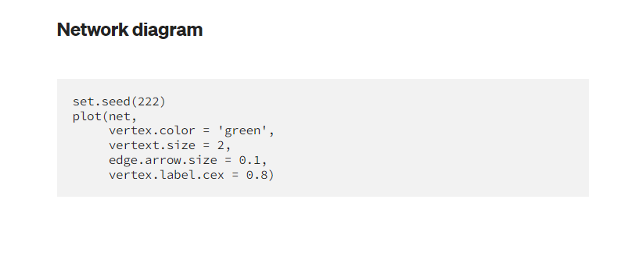
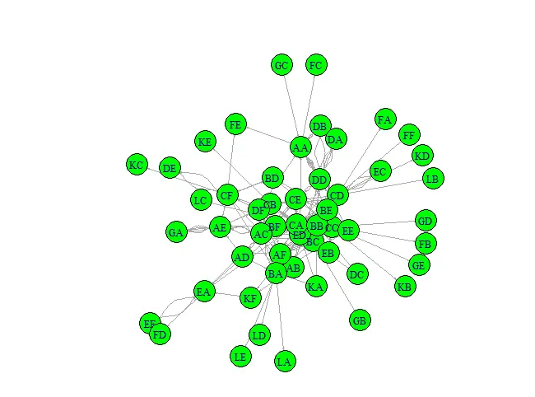

Slide 9
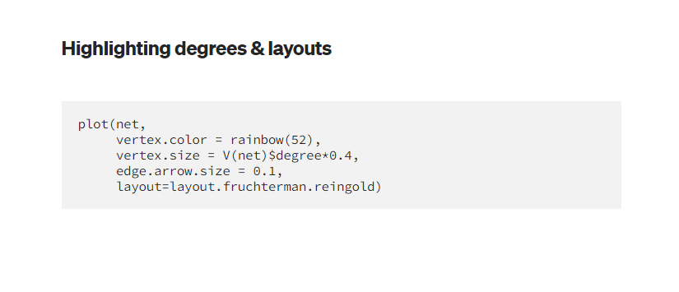
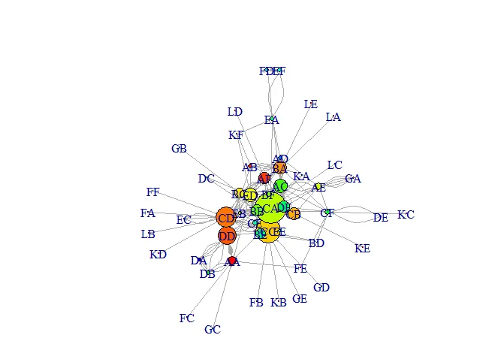


Slide 10
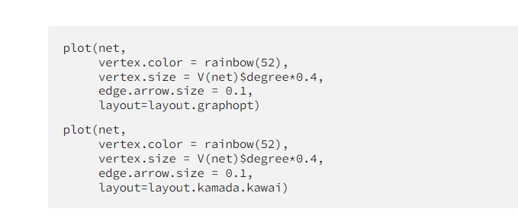

Slide 11
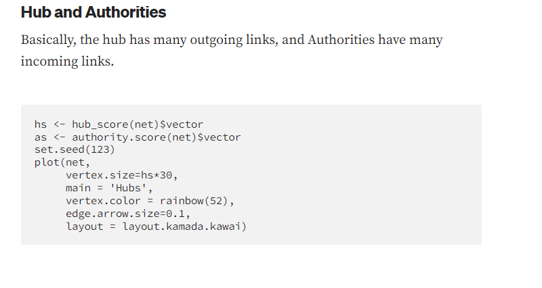
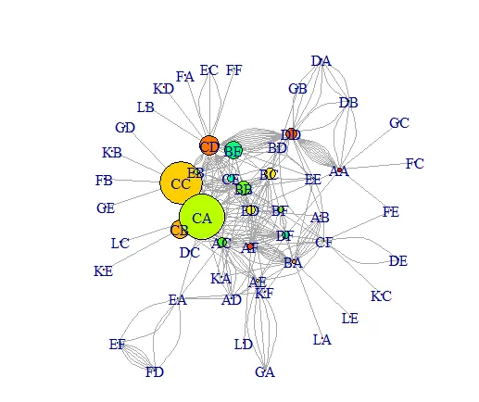


Slide 12
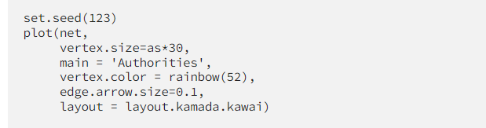
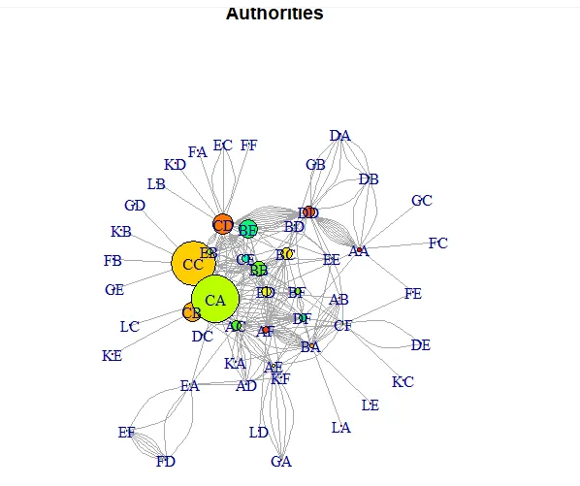


Slide 13
